Slide 1

VARDHAMAN COLLEGE OF ENGINEERING, HYDERABAD
Autonomous institute affiliated to JNTUH
DEPARTMENT OF COMPUTER SCIENCE & ENGINEERING
Title: Student Loyalty And Reward Management System
BATCH ID : 17CSPW-C4
S. No | Roll. No | Student Name
1 | 17881A05C1 | Akkem Abhinav Yadav
2 | 17881A05D5 | Deepak Singh Thakur
3 | 17881A05E7 | Cheripalli Namrath
Guide Details
Sowmya Dudyala
Assistant Professor
Department of CSE

Slide 2
Mini Project Review-1 Outlines
Main idea of the Project
Existing System Vs Proposed
Proposed Project Objectives
Proposed Project Outcomes
Process Model
Architectural Diagram
Software and Hardware Requirements
Summary of First Review
DEPARTMENT OF CSE MINI PROJECT REVIEW-1

Slide 3
Main idea of the Project
This application is used in an Organization and focuses on the Students rewards
The System generated tokens are used as loyalty points which are generated by the concept of Token generation in Cryptocurrency and which are managed by the Blockchain.
It is used with in the Organization or institutes where the students can use the loyalty points to conduct transactions. like , loyalty points can be redeemed within the campus for transactions or utilize to enroll in digital courses
If a student completes a task then the student will be rewarded with some tokens.
Eg: Tokens are awarded to the students as they progress through the defined milestones by the faculty . And as a reward, When a student Wins any competition or contest.
DEPARTMENT OF CSE MINI PROJECT REVIEW-1

Slide 4
Existing System Vs Proposed
Existing rewarding system allows users to redeem the reward with in the specific organization.
Proposed system generates the tokens that holds economical value. So, these tokens can be redeemed in exchange of services or products.
The current student reward system comprises of cash prize, trophies, certificates(handheld), coupons, loyalty points. But these tokens enables freedom to students to choose and utilize on something that truly holds value to oneself.
This even encourages students to participate in activities in pursuit of these tokens.
DEPARTMENT OF CSE MINI PROJECT REVIEW-1

Slide 5
Proposed Project Objectives
Token generation system:
It is implemented upon the Ethereum network (ERC-20).
These generated tokens could be used as the currency as they hold economical value.
Security Management System:
It ensures all the transactions to be consistent And provides security to all the user data.
It enables the user to get connected to the secured transaction tunnel during, making any kind of transaction .
User management system:
It manages all the user data and profiles. And user authentication system.
Account recovery system.
Wallet:
It holds all the received rewards and generated tokens.(External Accounts)
DEPARTMENT OF CSE MINI PROJECT REVIEW-1

Slide 6
Proposed Project Outcomes
Tokens are generated by ERC-20 as a result of validating the transaction
Simple signups compared to acquiring a bank account which has legal and complicated procedures and verification needs.
Better security and privacy of transactions because of block-chain.
Faster transactions compared to legacy banking methods(takes about 5-10sec).
Easy to manage and create.
DEPARTMENT OF CSE MINI PROJECT REVIEW-1

Slide 7
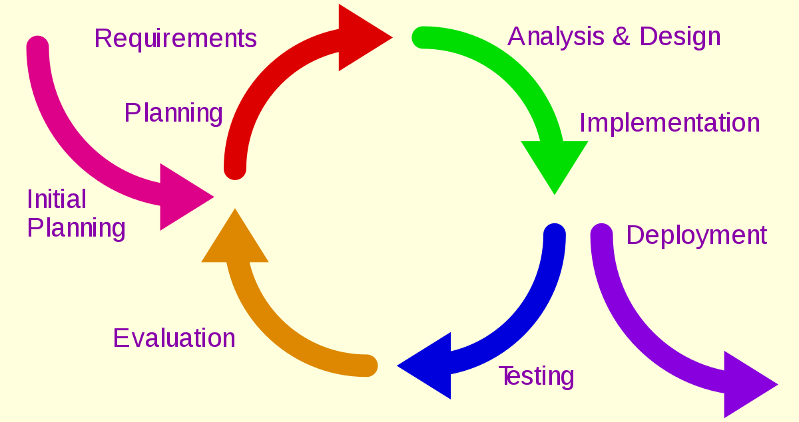
Process Model
ITERATIVE PROCESS MODEL
DEPARTMENT OF CSE MINI PROJECT REVIEW-1

Slide 8
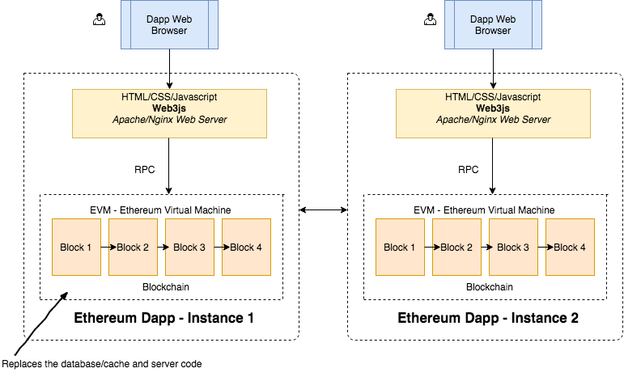
Architectural Diagram
.
DEPARTMENT OF CSE MINI PROJECT REVIEW-1

Slide 9
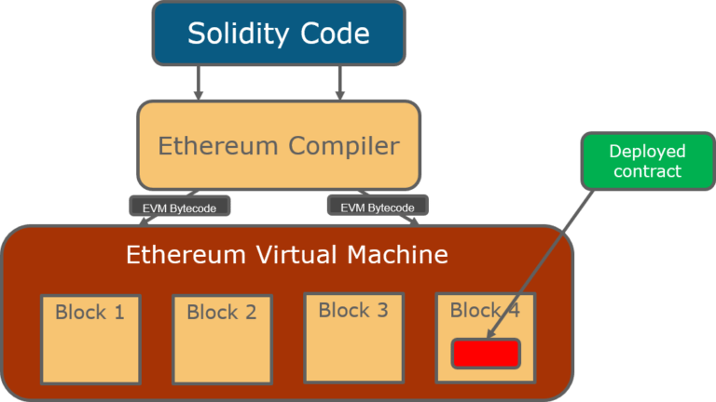
Architectural Diagram
DEPARTMENT OF CSE MINI PROJECT REVIEW-1

Slide 10
Software and Hardware Requirements
Software Requirements:
Ethereum network
ERC-20 (token generator)
Java Script
Solidity(creating smart contract )
Hardware Requirements:
Pc with RAM>4GB and windows 7/8/9/10 or mac os or ubuntu.
Mobile phone or Desktop
DEPARTMENT OF CSE MINI PROJECT REVIEW-1

Slide 11
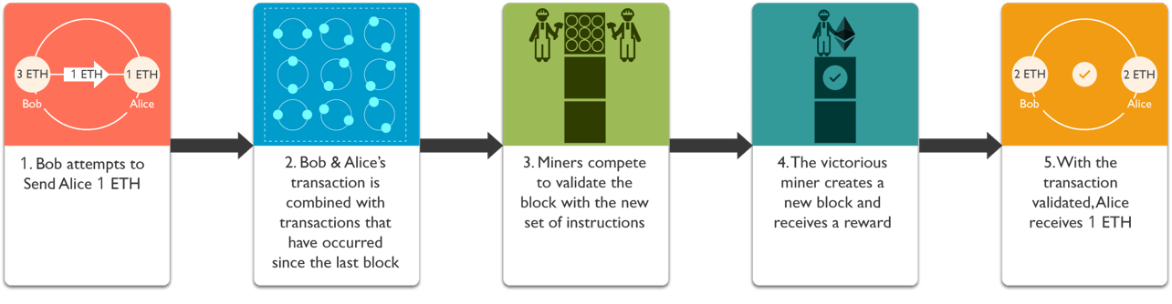
Summary of First Review
This application is used within the Organization by faculty and students. Faculty defines a milestones by which tokens or rewards are awarded to the students. And that tokens can be redeemed with in the organization like enrolling the digital course or paying dues in the library.
New token generation:
DEPARTMENT OF CSE MINI PROJECT REVIEW-1

Slide 12
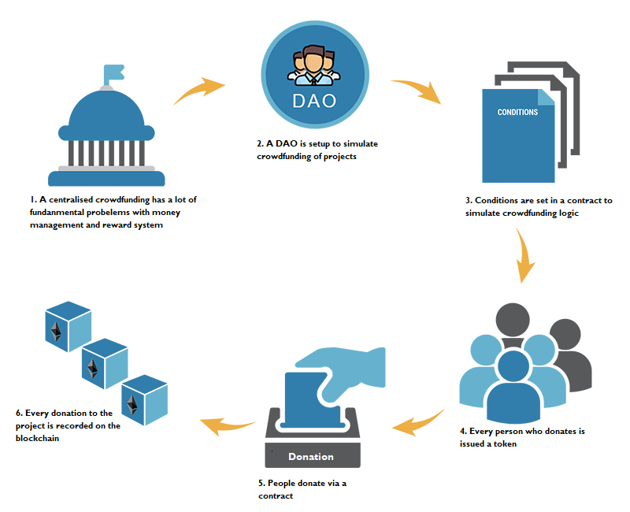
Summary of First Review
Economical value generation:
DEPARTMENT OF CSE MINI PROJECT REVIEW-1

Slide 13
Thank You
DEPARTMENT OF CSE MINI PROJECT REVIEW-1

